Slide 1
Introducing Error to ALEAF Input LMP Data

Slide 2
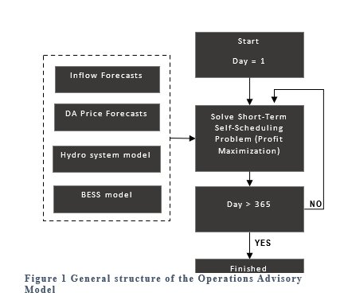
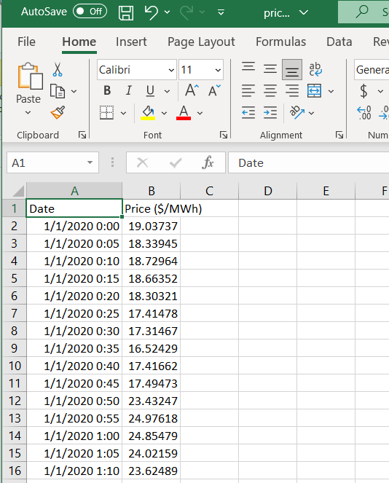
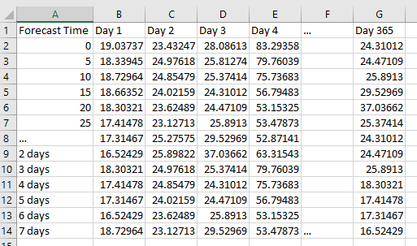
Approach for Price Forecast Error
User inputs year-long 5-min price
We need 7-day forecast for each day
Introduce error past day-ahead
Potential issue, no data here
Wrap back to beginning of data for forecast?

Slide 3
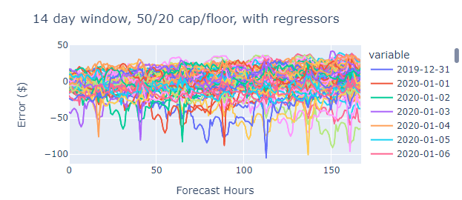
Price Forecast with ISO NE dataset
Using Prophet with different window sizes
Results example

Slide 4
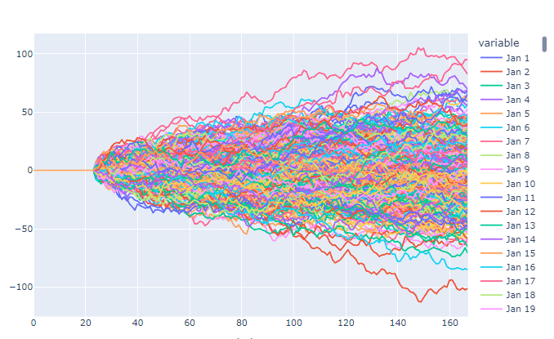
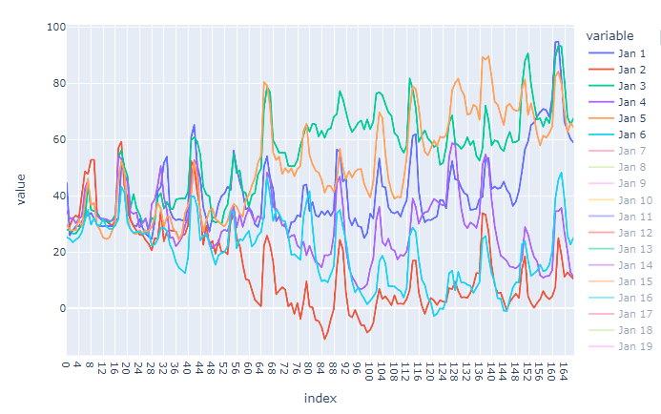
Random Walk With ISO-NE Error Data
Use ISO NE statistics
Generate random walk
Looks as expected
Add to LMP price

Slide 5
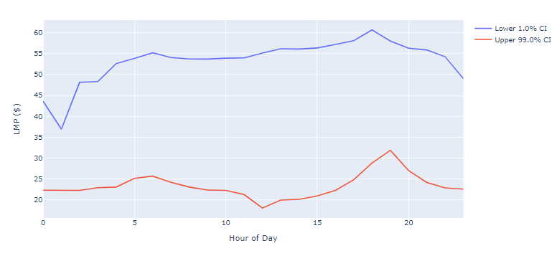
Bounding error/price
Make more sense to bound the error or the price?
Price
Approach
Random walk error
Add to input LMP for forecast
Bound the forecast at confidence intervals

Slide 6
Integration with ALEAF
Previously send multiple “error” files for Monte Carlo simulation
Now send file with price that includes the error
Store error file for analysis
Will single file work with ALEAF?
json file:
{“sim 1”: [prices], “sim 2”: [prices], …
Solves the time with saving hundreds or thousands of files

